Slide 1
Lab #6
Attitude Determination

Slide 2
Intro
In this lab you will build and test KestrelSAT’s attitude determination system including a sun sensor, a magnetometer, and a rate gyroscope.
You’ll examine KestrelSAT’s ability to determine rotation about it’s Z-axis (vertical axis) using these three sensors. You’ll gather data from each sensor and later calibrate and compare the attitude solutions given be each sensor.
During the lab, you’ll connect an Inertial Measurement Unit (IMU) to KestrelSAT’s MCU. Using this IMU, you’ll record angular rate and magnetic data.
You’ll also construct a sun sensor using four phototransistors and write code to determine KestrelSAT’s orientation relative to a light source using this sensor.
Authorized Resources - PRELAB
Prelab turn-in is individual effort
Generative AI Level 0 Allowed (GenAI not allowed)
Astro 331 course notes/ instructor
Intro
KestrelSAT
Reference
Task 1
Task 2
Task 3
Task 4
Task 5
Task 6
Task 7
Turn-in Reqt’s
Authorized Resources – LAB & LAB REPORT
Lab activities & lab report are team effort
Any non-human resource
Generative AI Level 3 Allowed
Astro 331 course notes/instructor
Objectives:
Understand fundamentals of attitude determination via practical experimentation.
Interpret gyroscope, magnetometer and phototransistor sensor measurements.
Build a functional sun sensor capable of sensing sun direction about 1 axis.
Develop calibration procedure for magnetometer data.
Understand how to integrate single-axis angular rate data to get angular position.

Slide 3
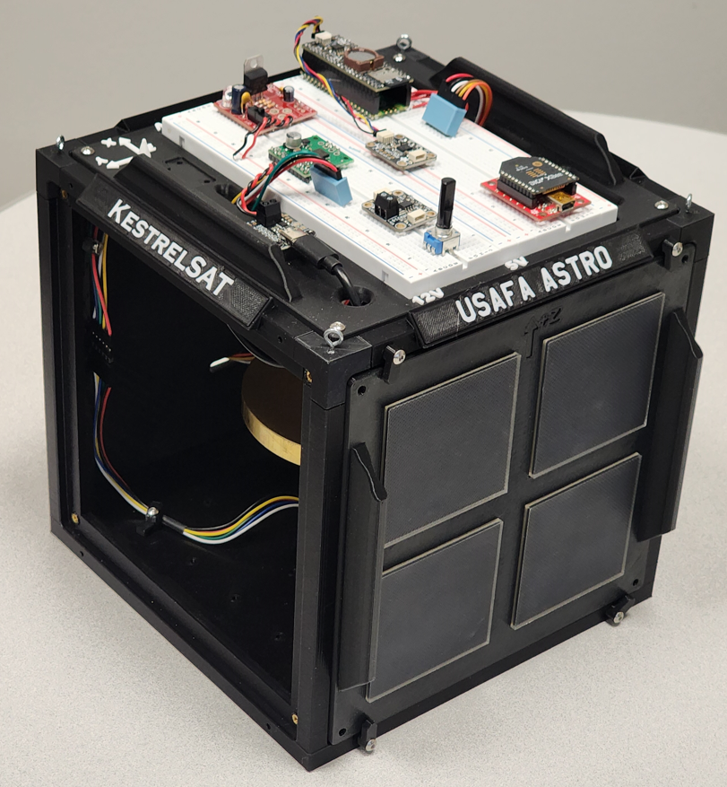
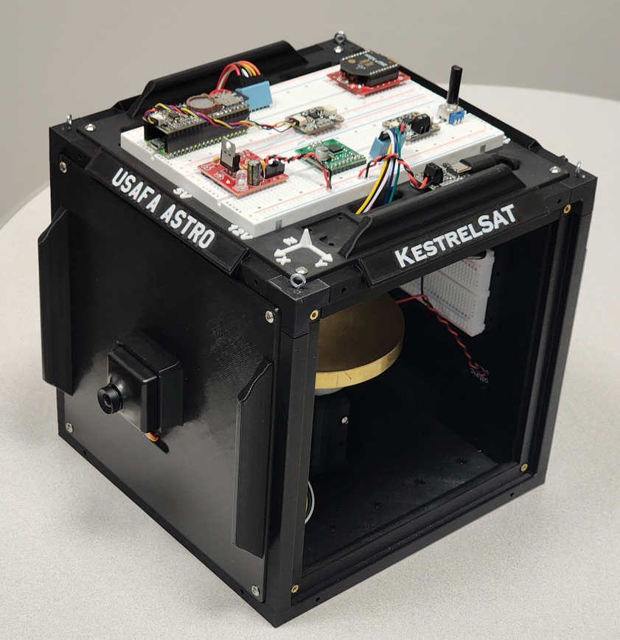
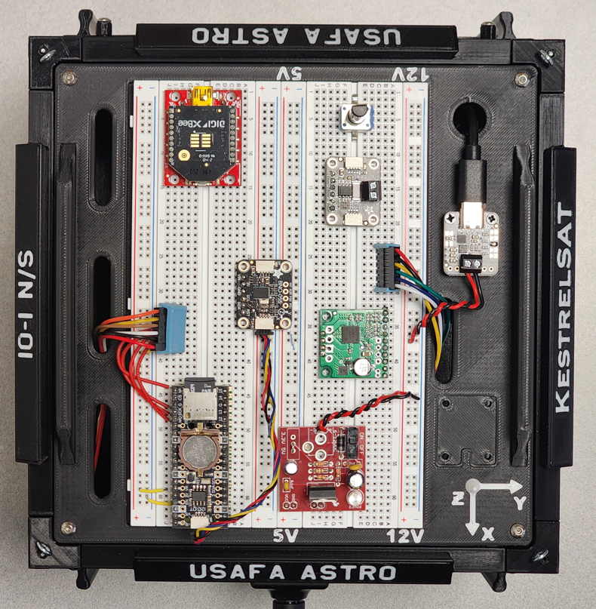
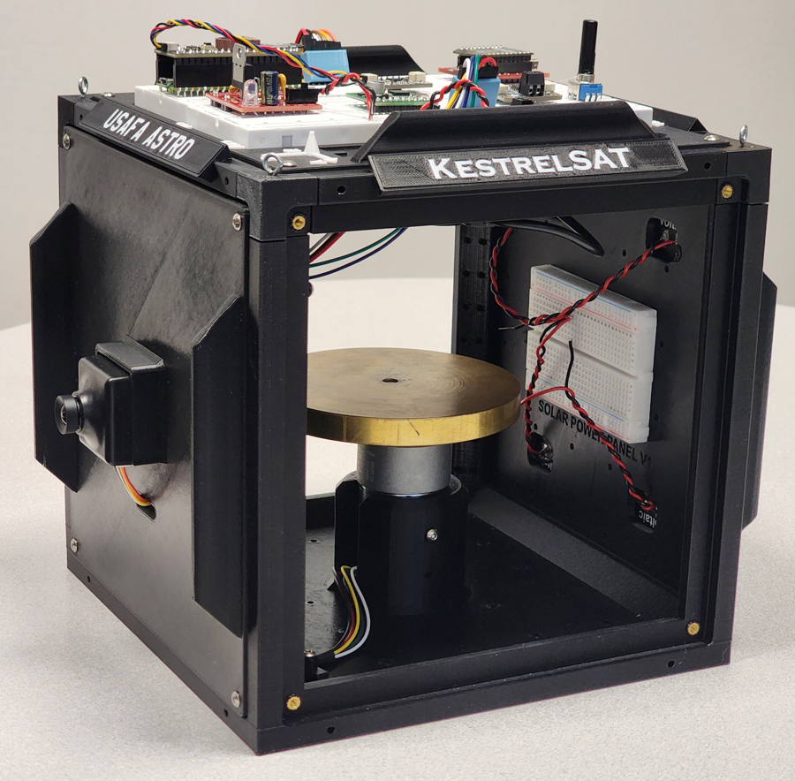
KestrelSAT Overview
Intro
KestrelSAT
Reference
Task 1
Task 2
Task 3
Task 4
Task 5
Task 6
Task 7
Turn-in Reqt’s
Solar Power Side
Reaction Wheel
Camera Side
Solar Power
V & I Sensor
Comm (Xbee transceiver)
Battery Controller
IMU (BNO055)
Motor Driver
MCU (Rpi Pico)
Memory (SD)
Real-Time Clock
12V DC to 5V DC Regulator

Slide 4
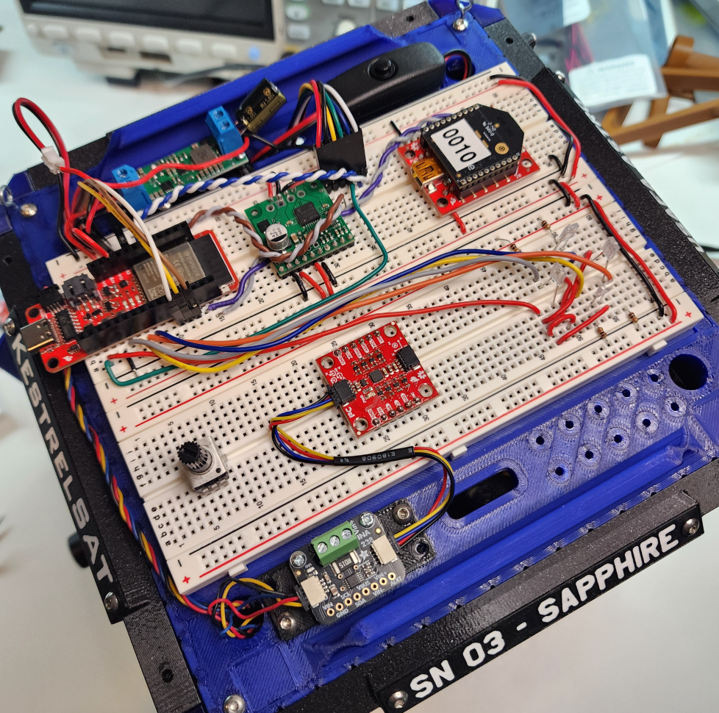
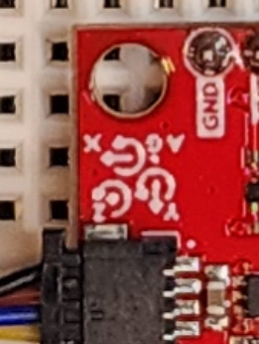
Reference – KestrelSAT Body Frame Coordinate System
Intro
KestrelSAT
Reference
Task 1
Task 2
Task 3
Task 4
Task 5
Task 6
Task 7
Turn-in Reqt’s
+Z points vertically up out of top of KestrelSAT
+Z
+
+
+X
+
+Y

Slide 5
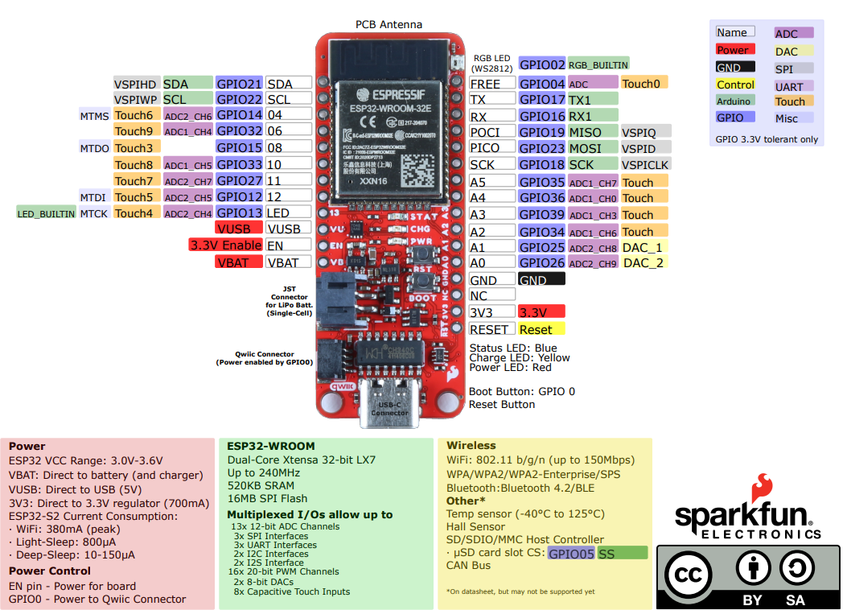
ESP32 Thing Plus Pinout Diagram
Intro
KestrelSAT
Reference
Task 1
Task 2
Task 3
Task 4
Task 5
Task 6
Task 7
Turn-in Reqt’s

Slide 6
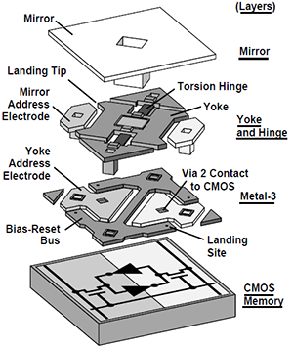
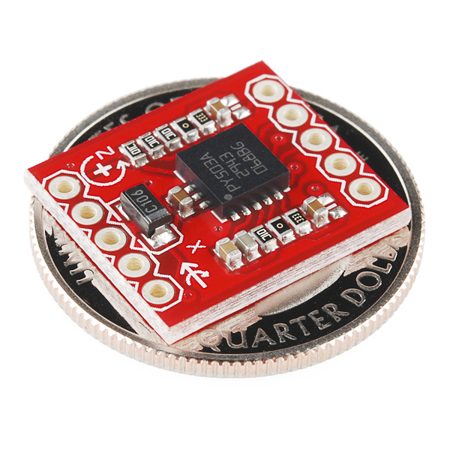
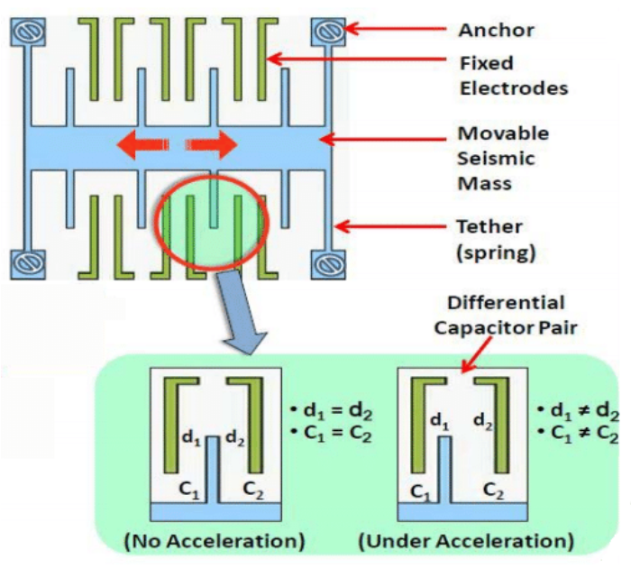
Reference – MEMS
Intro
KestrelSAT
Reference
Task 1
Task 2
Task 3
Task 4
Task 5
Task 6
Task 7
Turn-in Reqt’s
MEMS = Micro-Electro-Mechanical Systems
Tiny devices that combine mechanical elements, sensors, and electronics on a micrometer scale.
Fabricated using techniques similar to integrated circuits (ICs), often on silicon wafers.
MEMS are the enabling technology for miniaturized spacecraft ADCS and navigation systems.
Notes:
From VectorNav:
Up until the emergence of microelectromechanical systems (MEMS) technology, inertial sensors were high-cost, precision instruments, typically reserved for high-end applications.
As MEMS technology has matured, low-cost solid-state chip level inertial sensors have become available as alternatives to the larger high-end inertial sensors.

Slide 7
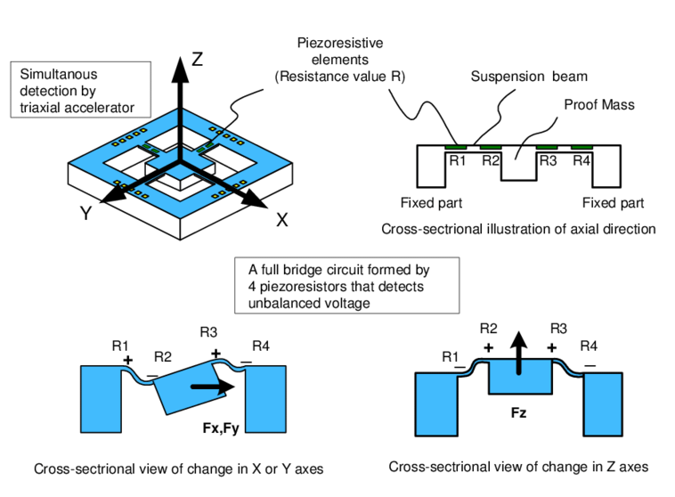
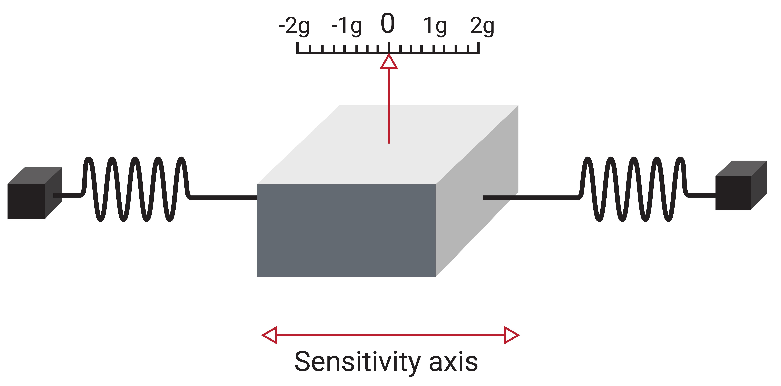
Reference – Accelerometer
Intro
KestrelSAT
Reference
Task 1
Task 2
Task 3
Task 4
Task 5
Task 6
Task 7
Turn-in Reqt’s
Inertial sensor that measures specific force (non-gravitational acceleration) in m/sec² or g.
→An accelerometer sitting on a table measures 1g, an accelerometer in free-fall measures 0g.
How it works:
Uses a proof mass suspended by springs or microstructures (MEMS).
When the sensor accelerates, the mass displaces; the displacement is converted into an electrical signal proportional to acceleration.
Limitations:
Cannot distinguish between linear acceleration and gravity alone.
→Since spacecraft are in free-fall, accelerometers have limited utility in space for sensing attitude orientation. We will not use an accelerometer during this lab.
Working principle of three-axis piezoresistive accelerometer
Single-Axis Simple Accelerometer Model
Notes:
https://www.vectornav.com/resources/inertial-navigation-primer/theory-of-operation/theory-mems

Slide 8
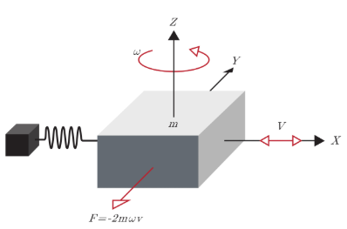
Reference – Gyroscope (sensor)
Intro
KestrelSAT
Reference
Task 1
Task 2
Task 3
Task 4
Task 5
Task 6
Task 7
Turn-in Reqt’s
An inertial sensor that measure an object's angular rate (rad/sec or deg/sec) with respect to an inertial reference frame.
How it works:
Traditional spinning-mass gyros: Detect Coriolis forces acting on a moving mass.
MEMS gyros: Use vibrating microstructures to sense angular rate.
Optical gyros (FOG/RLG): Use interference of light in a fiber or laser ring to measure rotation.
Limitations:
Drift/Bias: Over time, errors accumulate (gyro drift).
Power & Size Trade-offs: High-precision gyros (FOG/RLG) are bulkier and consume more power.
Require calibration and sensor fusion with star trackers or magnetometers for long-term accuracy.
Single-Axis Simple MEMS Gyroscope Model
Notes:
https://www.vectornav.com/resources/inertial-navigation-primer/theory-of-operation/theory-mems

Slide 9
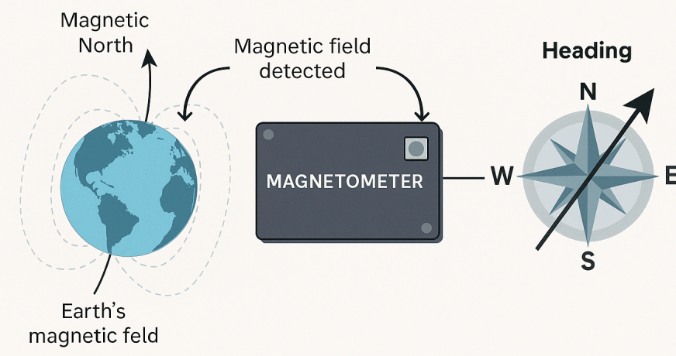
Reference – Magnetometer
Intro
KestrelSAT
Reference
Task 1
Task 2
Task 3
Task 4
Task 5
Task 6
Task 7
Turn-in Reqt’s
A sensor that measures the strength and direction of a magnetic field in Tesla (typically µT).
How it works:
Uses the Hall effect or fluxgate principles to sense magnetic field vectors.
Outputs a 3-axis vector that can be compared to Earth’s magnetic field model (IGRF) for attitude determination.
Limitations:
Accuracy depends on magnetic models (less effective far from Earth).
Sensitive to spacecraft magnetic noise (needs careful placement and calibration).
Provides only coarse attitude knowledge (not sufficient for fine pointing).
Notes:
https://www.pnisensor.com/importance-of-magnetometers-when-navigating/

Slide 10
Reference – Inertial Measurement Unit (IMU)
Intro
KestrelSAT
Reference
Task 1
Task 2
Task 3
Task 4
Task 5
Task 6
Task 7
Turn-in Reqt’s
A device that combines a 3-axis accelerometer, 3-axis gyroscope, and sometimes 3-axis magnetometer.
→ Used to determine linear and rotational motion
Limitations:
Drift over time (errors accumulate without external correction).
Requires sensor fusion (e.g., Kalman filters) with other sensors.
Higher-precision IMUs are large, heavy, and expensive.

Slide 11
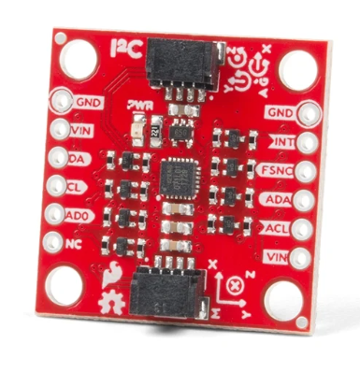
Reference – Sparkfun 9DOF IMU
Intro
KestrelSAT
Reference
Task 1
Task 2
Task 3
Task 4
Task 5
Task 6
Task 7
Turn-in Reqt’s
SparkFun 9DoF IMU Breakout incorporates InvenSense's ICM-20948
The ICM-20948 is a low-powered, I²C and SPI-enabled 9-axis MEMS device.
9-axis (aka 9DOF): 3-axis accelerometer + 3-axis gyroscope + 3-axis magnetometer
Triple-axis MEMS gyroscope with programmable full-scale range of ±250 dps, ±500 dps, ±1000 dps, and ±2000 dps
Triple-axis MEMS accelerometer with programmable full-scale range of ±2g, ±4g, ±8g, and ±16g
Triple-axis silicon monolithic Hall-effect magnetic sensor with full scale measurement range to ±4900 µT
This sensor will connect to KestrelSAT’s MCU over I2C using a QWIC cable.
https://www.sparkfun.com/sparkfun-9dof-imu-breakout-icm-20948-qwiic.html

Slide 12
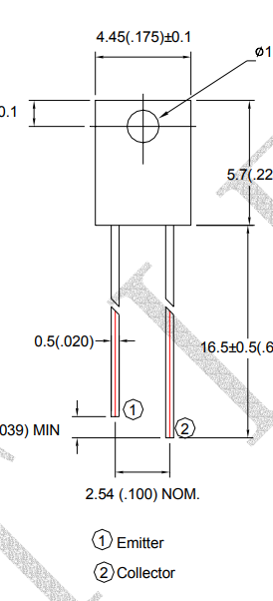
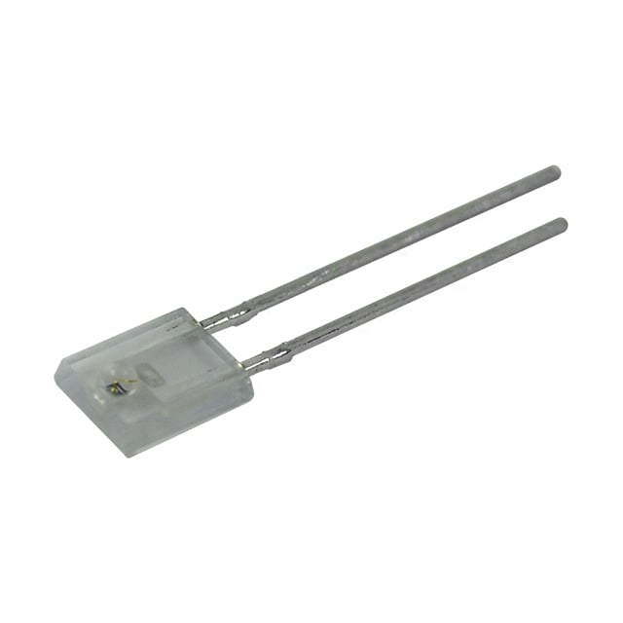

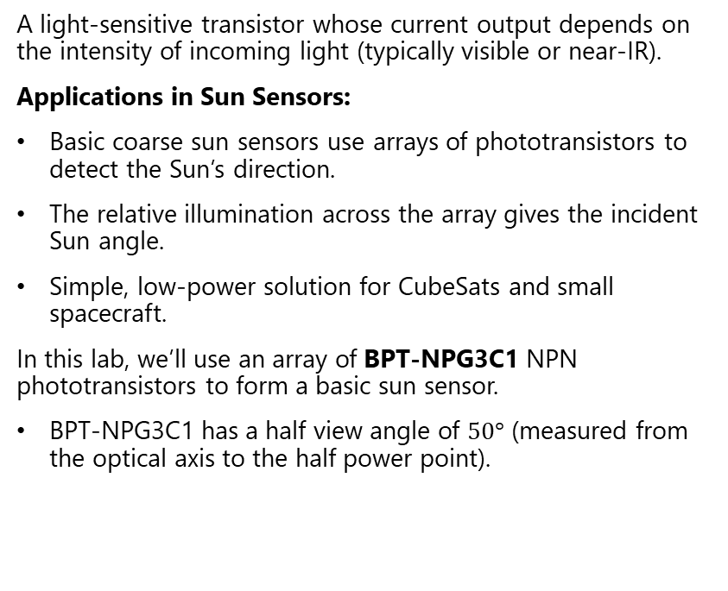
Reference – Phototransistor
Intro
KestrelSAT
Reference
Task 1
Task 2
Task 3
Task 4
Task 5
Task 6
Task 7
Turn-in Reqt’s
A light-sensitive transistor whose current output depends on the intensity of incoming light (typically visible or near-IR).
Applications in Sun Sensors:
Basic coarse sun sensors use arrays of phototransistors to detect the Sun’s direction.
The relative illumination across the array gives the incident Sun angle.
Simple, low-power solution for CubeSats and small spacecraft.
In this lab, we’ll use an array of BPT-NPG3C1 NPN phototransistors to form a basic sun sensor.
BPT-NPG3C1 has a half view angle of $50°$ (measured from the optical axis to the half power point).
Notes:
https://www.digikey.com/en/products/detail/american-bright-optoelectronics-corporation/BPT-NPG3C1/9678552
https://www.digikey.com/en/articles/the-basics-of-photodiodes-and-phototransistors-and-how-to-apply-them
https://www.digikey.com/en/maker/blogs/2022/how-to-use-a-phototransistor-with-an-arduino

Slide 13
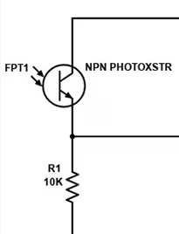
Task 1 – Build Sun Sensor
Intro
KestrelSAT
Reference
Task 1
Task 2
Task 3
Task 4
Task 5
Task 6
Task 7
Turn-in Reqt’s
KestrelSAT’s sun sensor consists of an array of four phototransistors capable of sensing the sun angle about the body frame Z-axis.
Connect four phototransistors to the MCU ADC pins A0-A3. Use a 10K resistor with each phototransistor. Align the phototransistors with +X/+Y/-X/-Y axes.
- The +X phototransistor should connect to A0
- The +Y phototransistor should connect to A1
- The -X phototransistor should connect to A2
- The -Y phototransistor should connect to A3
- Ensure phototransistors are connected to 3.3V of the MCU & GND
WARNING
Ensure you connect Phototransistors to 3.3V pin on the MCU, not 5V
Long Lead
3.3V
A{x}
(x=0/1/2/3)
+3.3V
Short Lead
GND

Slide 14
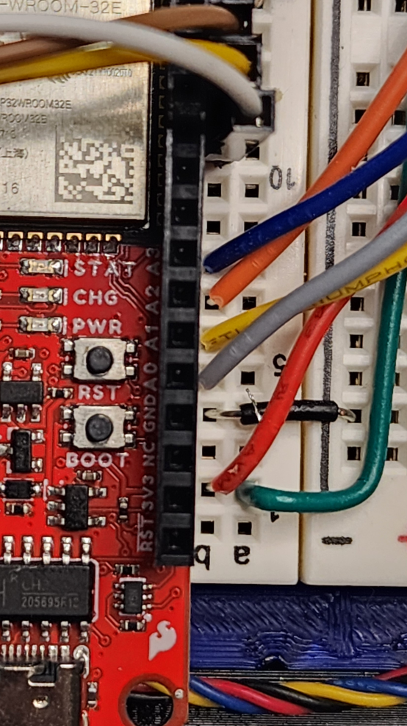
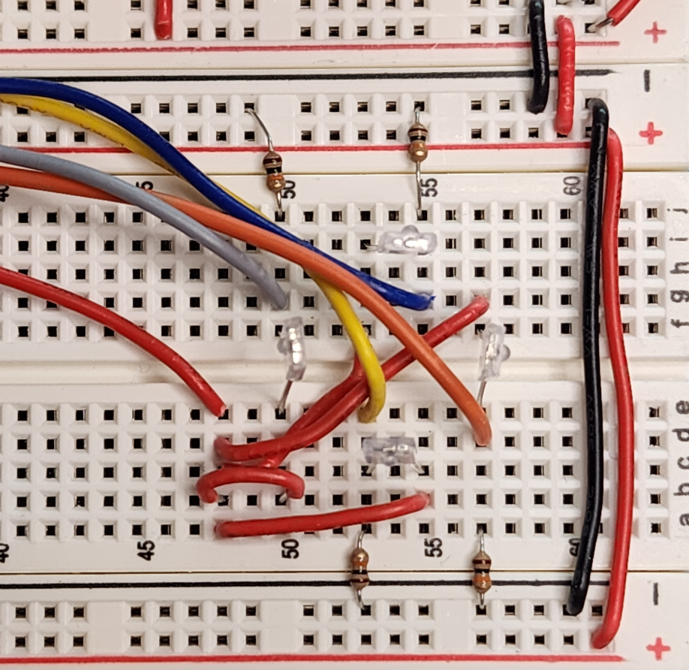
Task 1 – Additional Reference Photos
(
***Ensure bump on each Phototransistor faces out from the array***
*Trimming resistor leads is recommend*
Intro
KestrelSAT
Reference
Task 1
Task 2
Task 3
Task 4
Task 5
Task 6
Task 7
Turn-in Reqt’s
10KΩ
-Y
10KΩ
-X
+Y
-Y
+X
+X
+3.3V
-X
+3.3V
+Y
10KΩ
10KΩ

Slide 15
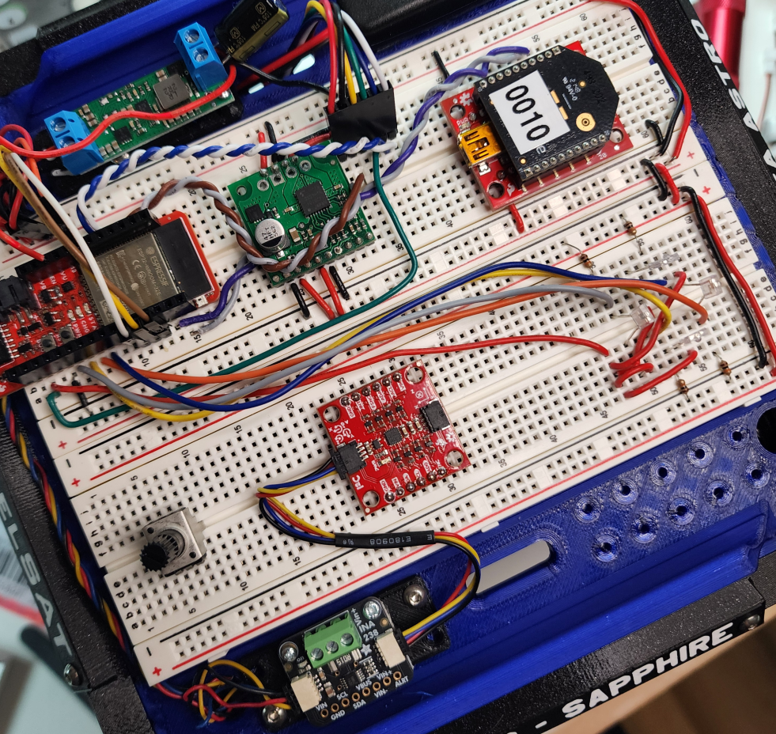
Task 2 – Connect IMU
Intro
KestrelSAT
Reference
Task 1
Task 2
Task 3
Task 4
Task 5
Task 6
Task 7
Turn-in Reqt’s
Connect the SparkFun 9DoF IMU Breakout to KestrelSAT MCU (via the INA238 board) using a QWIC cable.
***Ensure you insert the IMU in the orientation shown below***

Slide 16
Task 3 – Upload Code to KestrelSAT
Intro
KestrelSAT
Reference
Task 1
Task 2
Task 3
Task 4
Task 5
Task 6
Task 7
Turn-in Reqt’s
Download Astro331_Lab6_Code folder from Teams or your instructor’s USB drive.
Upload the code using PlatformIO. The RGB LED on the MCU should shine green if the IMU and SD card initialize correctly.
For this lab you can connect to KestrelSAT either over USB or using Xbee wireless connection. For either method, there are five available options:
1 : Print options menu
2 : Query and return the satellite radio RSSI via get_sat_rssi()
3 : Toggle the onboard LED on/off and report the new state
4 : Get Battery Information
5 : Execute Lab 6 Test Run (collect sun sensor & IMU data, save to SD, print to Serial)
Note: when a Lab 6 Test Run is executed, sensor data is only streamed over USB (not XBee). You’ll conduct sensor checkouts using USB, then conduct your Run For Record over XBee with the KestrelSAT hanging from the ceiling.
Each time a test run is executed, a new .csv file containing the test data is saved to the SD card connected to the MCU.

Slide 17
Task 4 – Sensor Checkouts
Intro
KestrelSAT
Reference
Task 1
Task 2
Task 3
Task 4
Task 5
Task 6
Task 7
Turn-in Reqt’s
With KestrelSAT connected via USB, open a serial terminal and start a test run. Observe sensor data using the Serial Plotter (toggle on/off data values as required).
Verify that each sensor is operating properly:
The gyro_Z value (angular rate about body Z axis) should be ~0 when KestrelSAT is still and should spike when KestrelSAT is rotated about it’s Z (vertical) axis.
mag_X and mag_Y values should change as you rotate KestrelSAT but remain steady when KestrelSAT is still.
sun_direction should remain 0 (you will write code for this value in the next task).
sun_plusX/sun_plusY/sun_minusX/sun_minusY should all be close to 0 when no light is shined on KestrelSAT and should output a higher value when light is shined on each phototransistor.
Confirm sun_{} values output correctly according to body axes as detailed in Task 1.

Slide 18
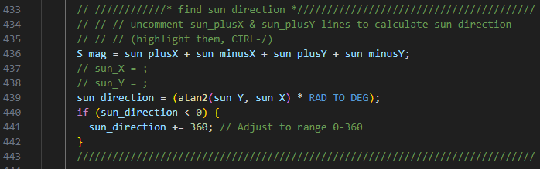
Task 5 – Code Sun Sensor Algorithm
Intro
KestrelSAT
Reference
Task 1
Task 2
Task 3
Task 4
Task 5
Task 6
Task 7
Turn-in Reqt’s
Uncomment code lines for sun_x, sun_y, and sun_direction located in the lab6_run_test() function.
Replace the ‘…’ in sun_x and sun_y with an appropriate expression: code an equation to find the sun’s brightness in the X direction and the Y direction.
Reupload the code and conduct another test run, this time analyzing the value for sun_direction by shining a light on each phototransistor:
- If +X is illuminated, sun_direction should be ~0/360 deg, +Y should be ~90 deg, -X should be ~180 deg, and –Y should be ~270 deg

Slide 19
Task 6 – Run for Record: Slow Spin
Intro
KestrelSAT
Reference
Task 1
Task 2
Task 3
Task 4
Task 5
Task 6
Task 7
Turn-in Reqt’s
Disconnect KestrelSAT from USB.
Hang KestrelSAT above your workstation using the 4-point hanging mount.
Connect your ground station Xbee transceiver that you used in Lab 4 (comm) to your computer.
Open KestrelSAT GUI and connect to the ground station Xbee.
Set up a fixed light source and orient KestrelSAT so it’s +X axis faces the light.
Turn on KestrelSAT using the onboard battery.
Confirm KestrelSAT is connected to the ground station and start a test run. Note the .csv file name so you know which file to retrieve from the SD card later.
Induce a slow spin (~less than one revolution per 3 seconds).
Let KestrelSAT spin for at least three revolutions and then stop KestrelSAT’s rotation.
Send ‘X’ over the telemetry connection to stop the test.

Slide 20
Task 7 – Run for Record: Fast Spin
Intro
KestrelSAT
Reference
Task 1
Task 2
Task 3
Task 4
Task 5
Task 6
Task 7
Turn-in Reqt’s
Repeat Task 6, with only change being to induce a faster spin (~1 revolution/sec).
Power down KestrelSAT and retrieve slow and fast spin test data from the SD card.
Confirm test data looks good before concluding lab efforts.

Slide 21
Lab Report 2 Guidance
***Note your Lab Report 2 will cover Lab #6 and Lab #7***
Intro
KestrelSAT
Reference
Task 1
Task 2
Task 3
Task 4
Task 5
Task 6
Task 7
Turn-in Reqt’s
In your Lab Report 2, analyze, compare and discuss orientation solutions provided by the gyroscope, magnetometer, and sun sensor. At a minimum, address the following:
The magnetometer data you collected for each test run is uncalibrated.
Develop a method to determine the gain and bias of your magnetometer measurements:
Remove the bias of your mag_X & mag_Y data so its centered around 0.
Adjust the full-scale range of your mag_X & mag_Y data to range from -1 to 1.
Using the calibrated magnetometer data, determine the magnetic heading using a method similar to that used for the sun sensor.
Integrate the gyro_Z data to determine the angular position of KestrelSAT.
- Using the initial magnetic heading you determined in Step (2) as your initial gyro heading.
- The MCU time is provided in msec in the first column of the .csv file to determine the time step between gyro measurements.
Compare magnetometer and gyroscope heading solutions (explain differences). Bonus points for discussing a method to fuse these measurements in order to improve the heading estimate.
Discuss methods for improving the sun sensor, such as changes to hardware configuration, embedded code algorithm, or post-processing of data (i.e. calibration of readings a la magnetometer data). Bonus points will be given if you implement/demonstrate any of these methods.

Slide 22
Deprecated Slides
(For reference only)
Notes:
Old Prelab Report Guidance: https://www.overleaf.com/read/bnhzqbwdqrdb#d19add ← DEPRECATED (DO NOT USE, FOR INSTRUCTOR REFERENCE ONLY)

Slide 23
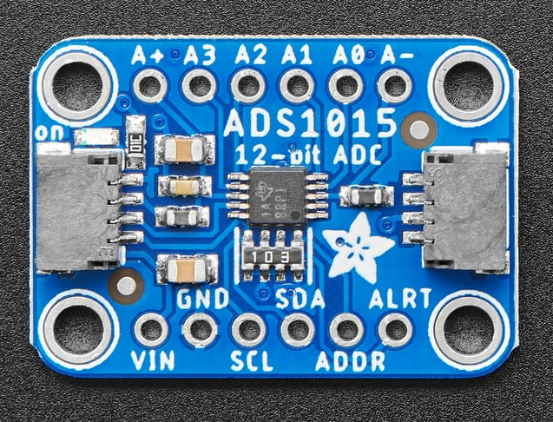
Reference – ADS1015 ADC Breakout
Intro
KestrelSAT
Reference
Prelab
Task 1
Task 2
Task 3
Task 4
Task 5
Task 6
Task 7
Turn-in Reqt’s
KestrelSAT’s MCU (Rpi Pico) does not have enough ADC channels to connect four phototransistors.
We will use an ADC expander breakout board (ADS1015) that provides four ADC channels for each phototransistor.
The 12-bit ADC channels are labeled A0, A1, A2, A3
Power/ground for the phototransistors will come from the A+ and A- pins of the breakout board.
This board will connect to KestrelSAT’s MCU over I2C using a QWIC cable.
https://www.adafruit.com/product/1083

